Slide 1
Faulted section identification and location
Notes:
Please Read this Notice Before you start working with this Template
Please Install the following Fonts and/or make sure its already available on your system.
Aller Font Family or at least Aller Light
Available @ fontsquirell.com
Callibri
Microsoft & Office System Font

Slide 2
Protection system flow
1
2
Application of ANN
OUR AGENDA
Training data
3
Faulted section identification and location
Faulted section identification
4
5
Fault location

Slide 3
Protection system flow
1
Power system
V, I
Input data
Fault detection and classification
Fault type
{ Online }
Faulted section identification
Tripping action for faulted section
Activation function
Faulted section locator
distance
{ Offline }
V, I of faulted section

Slide 4
2
Application of ANN
Pattern
Structure
Training
Evaluation
Protection system flow
1
Preparation of a suitable training data set that represents cases the ANN needs to learn.
Selection of a suitable ANN structure for a given application.
. Evaluation of the trained ANN using test patterns until its performance is satisfactory
Training the ANN

Slide 5
3
Training data
Protection system flow
Input pattern
1
2
Application of ANN
Output pattern

Slide 6
3
Training data
V, I
Power system
Extract 3 phase currents and voltages
cases
Large different cases to generate input data
DFT
Discrete Fourier transform
sampling
At 20 KHz

Slide 7
3
Training data

Slide 8
Faulted section identification
4
Nine measuring points
This approach has used measurements from all buses taking magnitudes of three-phase currents and voltages as input to the ANN block
Training data
3
Training and testing
Three measuring points
This approach has tried to used reduced data in order to reduce complexity and large data transfer

Slide 9
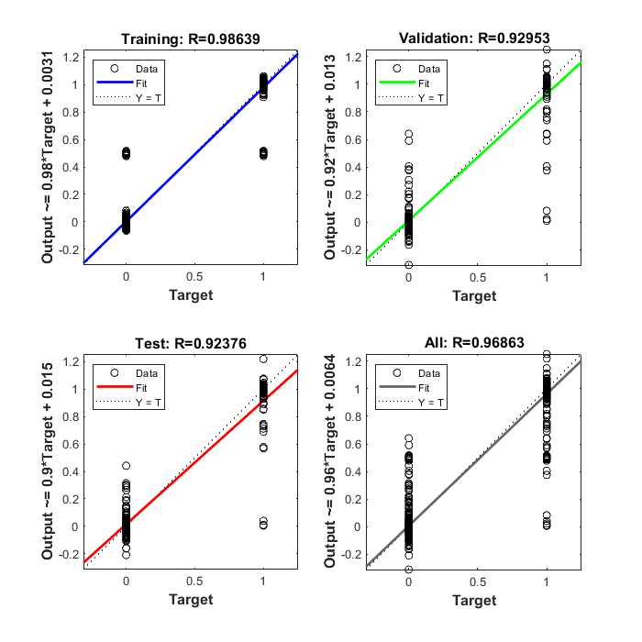
Faulted section identification
Nine measuring points
4
moduar ANN faulted section detector | layers | input |  | hidden |  | Output |  | Training | epochs
 |  | neurons | function | neurons | function | neurons | function
1st approach | 3 | 54 | TANSIG | 30 | TANSING | 6 | PURELIN | 0.986 | 60
2nd approach | 4 | 54 | LOGSIG | 30 , 10 | TANSING | 6 | PURELIN | 0.985 | 56
3rd approach | 3 | 54 | TANSIG | 20 | TANSING | 6 | TANSING | 0.97 | 42
Training
Input (54 neurons)
Hidden (30 neurons)
Output (6 neurons)
Current and voltage magnitudes of 3 buses
Faulted section

Slide 10
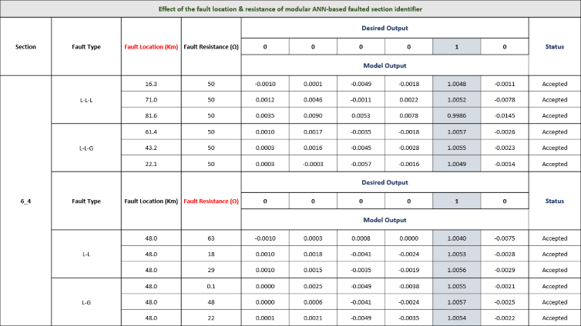
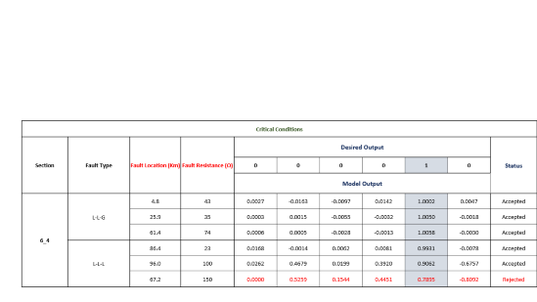
Faulted section identification
Nine measuring points
4
Test
Training

Slide 11
Effect of the fault location & resistance of modular ANN-based faulted section identifier
Section | Fault Type | Fault Location (Km) | Fault Resistance (Ω) | Desired Output |  |  |  |  |  | Status
 |  |  |  | 0 | 0 | 0 | 0 | 1 | 0
 |  |  |  | Model Output
6_4 | L-L-L | 16.3 | 50 | -0.0010 | 0.0001 | -0.0049 | -0.0018 | 1.0048 | -0.0011 | Accepted
 |  | 71.0 | 50 | 0.0012 | 0.0046 | -0.0011 | 0.0022 | 1.0052 | -0.0078 | Accepted
 |  | 81.6 | 50 | 0.0035 | 0.0090 | 0.0053 | 0.0078 | 0.9986 | -0.0145 | Accepted
 | L-L-G | 61.4 | 50 | 0.0010 | 0.0017 | -0.0035 | -0.0018 | 1.0057 | -0.0026 | Accepted
 |  | 43.2 | 50 | 0.0003 | 0.0016 | -0.0045 | -0.0028 | 1.0055 | -0.0023 | Accepted
 |  | 22.1 | 50 | 0.0003 | -0.0003 | -0.0057 | -0.0016 | 1.0049 | -0.0014 | Accepted
 | Fault Type | Fault Location (Km) | Fault Resistance (Ω) | Desired Output |  |  |  |  |  | Status
 |  |  |  | 0 | 0 | 0 | 0 | 1 | 0
 |  |  |  | Model Output
 | L-L | 48.0 | 63 | -0.0010 | 0.0003 | 0.0008 | 0.0000 | 1.0040 | -0.0075 | Accepted
 |  | 48.0 | 18 | 0.0010 | 0.0018 | -0.0041 | -0.0024 | 1.0053 | -0.0028 | Accepted
 |  | 48.0 | 29 | 0.0010 | 0.0015 | -0.0035 | -0.0019 | 1.0056 | -0.0029 | Accepted
 | L-G | 48.0 | 0.1 | 0.0000 | 0.0025 | -0.0049 | -0.0038 | 1.0055 | -0.0021 | Accepted
 |  | 48.0 | 48 | 0.0000 | 0.0006 | -0.0041 | -0.0024 | 1.0057 | -0.0025 | Accepted
 |  | 48.0 | 22 | 0.0001 | 0.0021 | -0.0049 | -0.0035 | 1.0054 | -0.0022 | Accepted

Slide 12
Critical Conditions
Section | Fault Type | Fault Location (Km) | Fault Resistance (Ω) | Desired Output |  |  |  |  |  | Status
 |  |  |  | 0 | 0 | 0 | 0 | 1 | 0
 |  |  |  | Model Output
6_4 | L-L-G | 4.8 | 43 | 0.0027 | -0.0163 | -0.0097 | 0.0142 | 1.0002 | 0.0047 | Accepted
 |  | 25.9 | 35 | 0.0003 | 0.0015 | -0.0055 | -0.0032 | 1.0050 | -0.0018 | Accepted
 |  | 61.4 | 74 | 0.0006 | 0.0005 | -0.0028 | -0.0013 | 1.0058 | -0.0030 | Accepted
 | L-L-L | 86.4 | 23 | 0.0168 | -0.0014 | 0.0062 | 0.0081 | 0.9931 | -0.0078 | Accepted
 |  | 96.0 | 100 | 0.0262 | 0.4679 | 0.0199 | 0.3920 | 0.9062 | -0.6757 | Accepted
 |  | 67.2 | 150 | 0.0000 | 0.5259 | 0.1544 | 0.4451 | 0.7895 | -0.8092 | Rejected

Slide 13
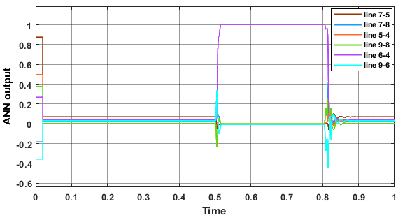
Faulted section identification
Nine measuring points
4
Test
Training
ANN output at 74Ω, 61.4Km on line 6-4

Slide 14
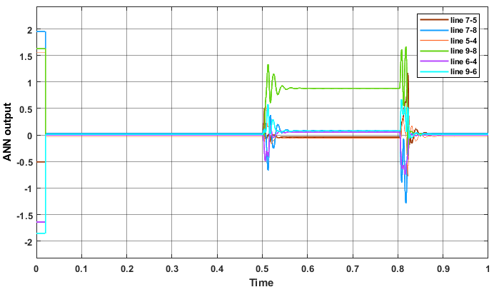
Faulted section identification
Nine measuring points
4
Test
Training
ANN output at 14Ω , 34.5KM at line 9-8

Slide 15
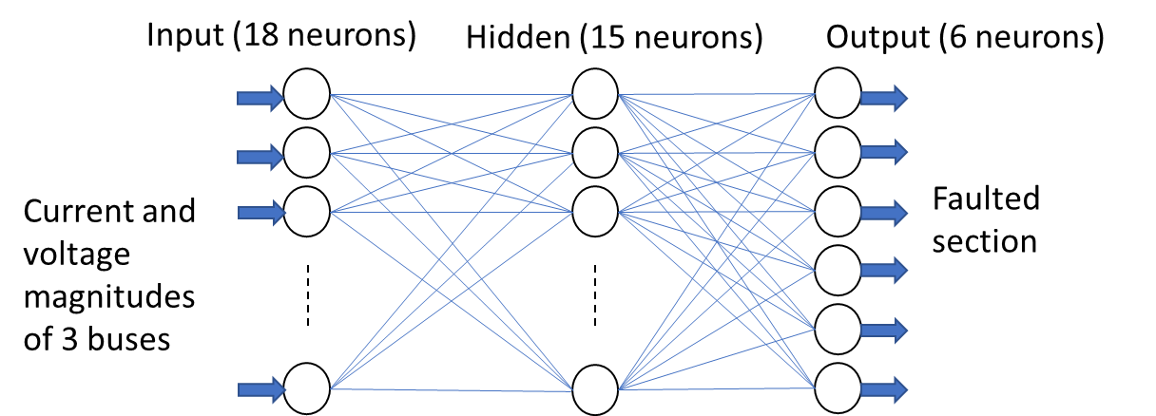

Faulted section identification
Three measuring points
4
Modular ANN faulted section identifier | layers | input |  | hidden |  | Output |  | epochs
 |  | neurons | function | neurons | function | neurons | function
Bus 1_2_3 | 4 | 18 | LOGSIG | 15,10 | TANSING | 6 | PURELIN | 30
Bus 4_7_9 | 3 | 18 | TANSIG | 15 | TANSING | 6 | PURELIN | 24
Bus 5_6_8 | 3 | 18 | TANSIG | 15 | TANSING | 6 | PURELIN | 21
Training
Training
Nine measuring points
Training
Test

Slide 16
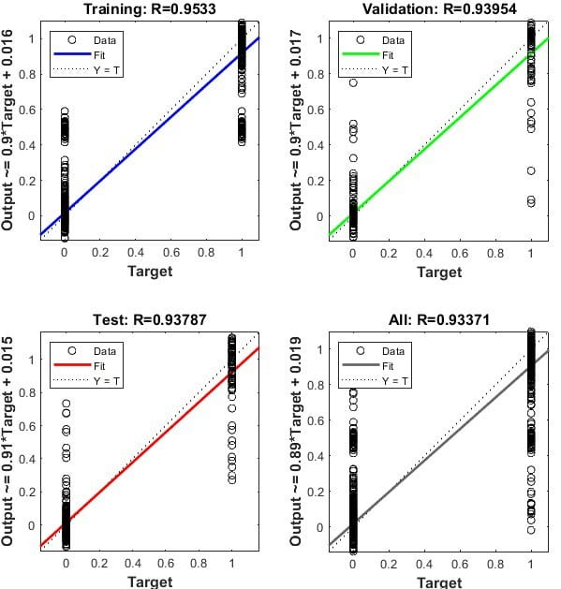
Notes:
Please Read this Notice Before you start working with this Template
Please Install the following Fonts and/or make sure its already available on your system.
Aller Font Family or at least Aller Light
Available @ fontsquirell.com
Callibri
Microsoft & Office System Font

Slide 17
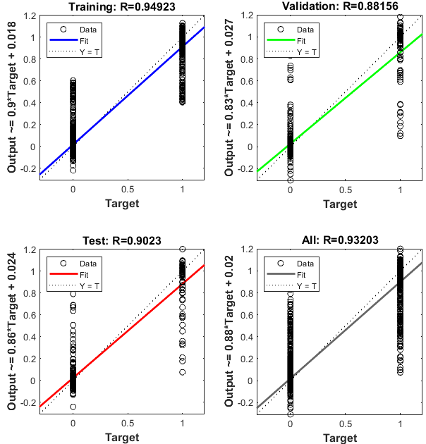
Notes:
Please Read this Notice Before you start working with this Template
Please Install the following Fonts and/or make sure its already available on your system.
Aller Font Family or at least Aller Light
Available @ fontsquirell.com
Callibri
Microsoft & Office System Font

Slide 18
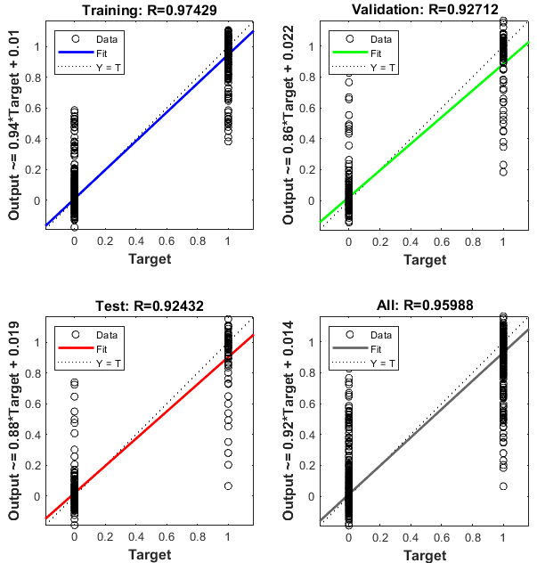
Notes:
Please Read this Notice Before you start working with this Template
Please Install the following Fonts and/or make sure its already available on your system.
Aller Font Family or at least Aller Light
Available @ fontsquirell.com
Callibri
Microsoft & Office System Font

Slide 19
Faulted section identification
Three measuring points
4
Effect of the fault location of modular ANN-based faulted section identifier
Section | Fault Type | Fault Location (Km) | Fault Resistance (Ω) | Desired Output |  |  |  |  |  | Status
 |  |  |  | 1 | 0 | 0 | 0 | 0 | 0
 |  |  |  | Model Output
7_5 | L-G | 21.2 | 50 | 0.9831 | 0.0021 | -0.0093 | -0.0047 | 0.0198 | 0.0036 | Accepted
 |  | 44.2 | 50 | 1.0182 | 0.0121 | -0.0487 | 0.0044 | 0.0149 | -0.0050 | Accepted
 |  | 79.5 | 0 | 1.0117 | 0.0104 | -0.0335 | 0.0125 | 0.0034 | -0.0060 | Accepted
 | L-L | 93.7 | 50 | 1.0064 | 0.0097 | -0.0095 | 0.0107 | -0.0113 | -0.0153 | Accepted
 |  | 152.0 | 50 | 1.0064 | -0.0073 | 0.0249 | 0.0155 | -0.0019 | -0.0213 | Accepted
 |  | 67.1 | 0 | 1.0035 | -0.0020 | -0.0023 | 0.0005 | -0.0011 | -0.0011 | Accepted
Test
Training
Effect of the fault location of modular ANN-based faulted section identifier
BUS 1,2,3 |  |  |  |  |  | BUS 4,7,9 |  |  |  |  |  | BUS 5,6,8
0.945 | -0.006 | 0.028 | -0.002 | -0.045 | 0.125 | 0.894 | 0.002 | 0.125 | 0.002 | -0.016 | -0.011 | 0.860 | 0.023 | 0.141 | -0.025 | -0.019 | 0.004
1.003 | -0.011 | -0.006 | 0.001 | -0.008 | 0.026 | 1.009 | -0.016 | 0.023 | 0.013 | -0.027 | -0.007 | 0.904 | 0.008 | 0.094 | -0.007 | -0.008 | -0.010
1.010 | -0.010 | -0.003 | 0.002 | 0.005 | -0.012 | 1.028 | -0.028 | 0.002 | 0.015 | -0.026 | 0.002 | 0.962 | -0.010 | 0.035 | 0.010 | 0.006 | -0.024
1.011 | -0.009 | -0.003 | 0.002 | 0.006 | -0.015 | 1.021 | -0.008 | 0.019 | -0.010 | -0.029 | 0.009 | 0.987 | -0.030 | 0.005 | -0.050 | 0.006 | 0.062
1.006 | -0.011 | -0.002 | 0.005 | 0.005 | -0.010 | 1.026 | -0.018 | -0.025 | -0.002 | 0.012 | 0.005 | 1.009 | 0.003 | 0.006 | -0.019 | -0.004 | 0.022
0.812 | 0.208 | -0.005 | -0.012 | 0.006 | -0.017 | 0.922 | 0.087 | 0.000 | -0.008 | -0.008 | 0.009 | 0.991 | 0.125 | -0.025 | -0.020 | -0.087 | 0.010

Slide 20
Faulted section identification
Three measuring points
4
Effect of the fault resistance of modular ANN-based faulted section identifier
Section | Fault Type | Fault Location (Km) | Fault Resistance (Ω) | Desired Output |  |  |  |  |  | Status
 |  |  |  | 1 | 0 | 0 | 0 | 0 | 0
 |  |  |  | Model Output
7_5 | L-L-G | 88.4 | 0.1 | 1.0046 | 0.0027 | -0.0045 | 0.0024 | -0.0018 | -0.0057 | Accepted
 |  | 88.4 | 5 | 0.8689 | -0.0304 | 0.2107 | 0.0541 | 0.0000 | -0.0486 | Accepted
 |  | 88.4 | 15 | 0.7253 | -0.0396 | 0.4104 | 0.0745 | -0.0215 | -0.0738 | Rejected
 | L-L-L | 88.4 | 29 | 0.5830 | -0.0556 | 0.3802 | -0.0177 | 0.0692 | -0.0014 | Rejected
 |  | 88.4 | 46 | 1.0165 | 0.0364 | -0.0338 | 0.0045 | -0.0324 | 0.0117 | Accepted
 |  | 88.4 | 70 | 1.3041 | 0.0688 | -0.3520 | -0.0463 | 0.0068 | 0.0134 | Rejected
Test
Training
Effect of the fault resistance of modular ANN-based faulted section identifier
BUS 1,2,3 |  |  |  |  |  | BUS 4,7,9 |  |  |  |  |  | BUS 5,6,8
1.007 | -0.009 | -0.002 | 0.005 | 0.006 | -0.015 | 1.025 | -0.019 | -0.024 | -0.001 | 0.012 | 0.003 | 0.950 | 0.017 | 0.069 | -0.003 | -0.002 | -0.006
1.008 | -0.008 | -0.003 | 0.005 | 0.006 | -0.016 | 1.026 | -0.020 | -0.024 | 0.002 | 0.010 | 0.002 | 0.931 | 0.019 | 0.090 | -0.013 | -0.001 | 0.001
1.009 | -0.008 | -0.003 | 0.004 | 0.006 | -0.016 | 1.027 | -0.023 | -0.023 | 0.011 | 0.006 | 0.000 | 0.926 | 0.008 | 0.094 | 0.003 | 0.009 | -0.014
1.006 | -0.011 | -0.003 | 0.004 | 0.004 | -0.007 | 1.015 | 0.001 | -0.020 | 0.007 | 0.021 | -0.022 | 0.912 | 0.043 | 0.097 | -0.103 | -0.050 | 0.115
1.007 | -0.011 | -0.003 | 0.004 | 0.004 | -0.009 | 1.011 | 0.008 | 0.002 | 0.011 | -0.001 | -0.028 | 0.979 | -0.032 | 0.017 | -0.022 | -0.002 | 0.051
1.007 | -0.010 | -0.003 | 0.004 | 0.004 | -0.010 | 0.998 | 0.008 | 0.081 | 0.091 | -0.093 | -0.084 | 0.926 | -0.111 | 0.057 | 0.069 | 0.048 | -0.023

Slide 21
Faulted section identification
Three measuring points
4
Critical Conditions
Section | Fault Type | Fault Location (Km) | Fault Resistance (Ω) | Desired Output |  |  |  |  |  | Status
 |  |  |  | 1 | 0 | 0 | 0 | 0 | 0
 |  |  |  | Model Output
7_5 | L-L | 150.2 | 0.5 | 1.0980 | -0.0099 | -0.0736 | 0.0068 | -0.0064 | -0.0135 | Accepted
 |  | 169.6 | 8 | 0.7049 | 0.2217 | 0.0287 | -0.0618 | 0.0048 | 0.0726 | Rejected
 |  | 113.1 | 32 | 0.5134 | -0.0556 | 0.7993 | 0.0550 | -0.2477 | -0.0897 | Rejected
 | L-G | 63.6 | 55 | 1.0768 | -0.0110 | -0.0893 | -0.0029 | 0.0270 | -0.0168 | Accepted
 |  | 33.6 | 65 | 1.1048 | 0.0117 | -0.1680 | -0.0238 | 0.0740 | -0.0484 | Accepted
 |  | 144.9 | 80 | 1.2150 | 0.0733 | -0.2939 | 0.0562 | 0.0386 | -0.1792 | Accepted
Test
Training
Critical Conditions
BUS 1,2,3 |  |  |  |  |  | BUS 4,7,9 |  |  |  |  |  | BUS 5,6,8
0.669 | 0.341 | -0.003 | -0.006 | 0.004 | -0.013 | 1.016 | -0.011 | -0.025 | 0.002 | 0.016 | -0.005 | 1.001 | 0.017 | 0.019 | 0.028 | 0.003 | -0.037
0.022 | 0.968 | 0.002 | 0.005 | -0.001 | 0.002 | 0.883 | 0.127 | -0.022 | -0.009 | 0.019 | -0.001 | 0.893 | 0.152 | 0.047 | 0.218 | -0.073 | -0.217
1.016 | -0.007 | -0.004 | -0.004 | 0.006 | -0.018 | 1.026 | -0.021 | -0.010 | 0.009 | -0.008 | 0.002 | 1.066 | 0.002 | -0.061 | 0.024 | 0.016 | -0.035
1.008 | -0.011 | -0.004 | 0.002 | 0.002 | -0.003 | 1.023 | -0.024 | 0.008 | 0.022 | -0.027 | -0.007 | 0.934 | -0.002 | 0.063 | 0.003 | 0.000 | -0.018
0.987 | -0.008 | 0.000 | 0.000 | -0.024 | 0.067 | 0.944 | -0.007 | 0.062 | 0.050 | -0.013 | -0.043 | 0.866 | 0.007 | 0.131 | -0.007 | -0.008 | -0.007
0.871 | 0.141 | -0.004 | -0.004 | 0.006 | -0.017 | 0.844 | 0.143 | 0.006 | 0.029 | -0.042 | 0.006 | 0.867 | 0.138 | 0.115 | -0.017 | -0.073 | -0.014

Slide 22
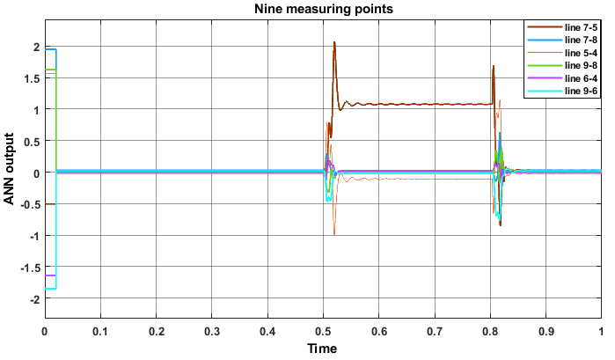

Slide 23
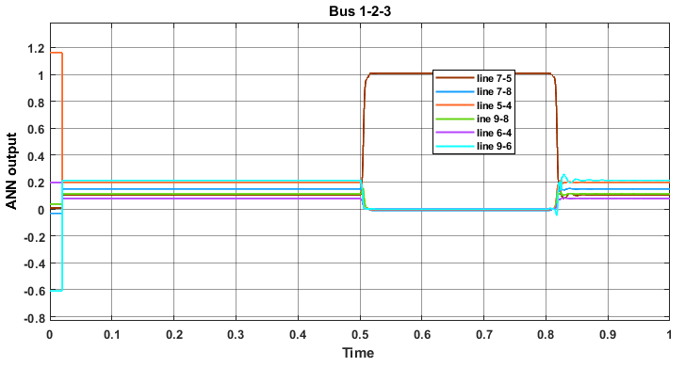

Slide 24
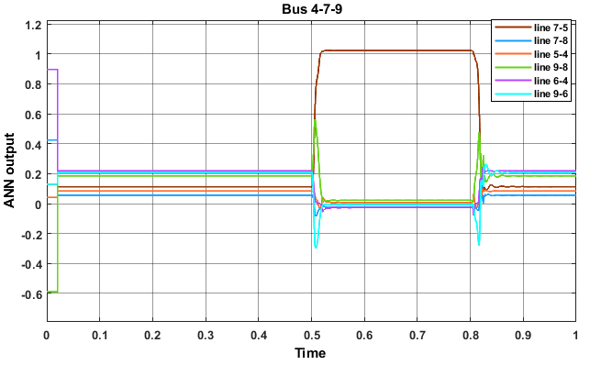

Slide 25
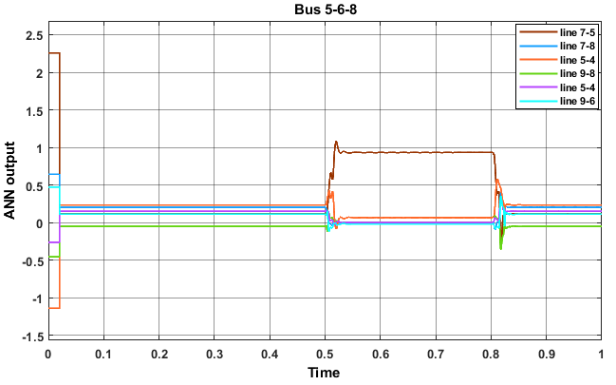
5
Fault location

Slide 26
5
Fault location
offline
Three phase currents and voltage from both ends are fed to ANN
Step
03
Fault distance (Km)
Step
Fault location activation
02
Step
Isolating the faulted section
01

Slide 27
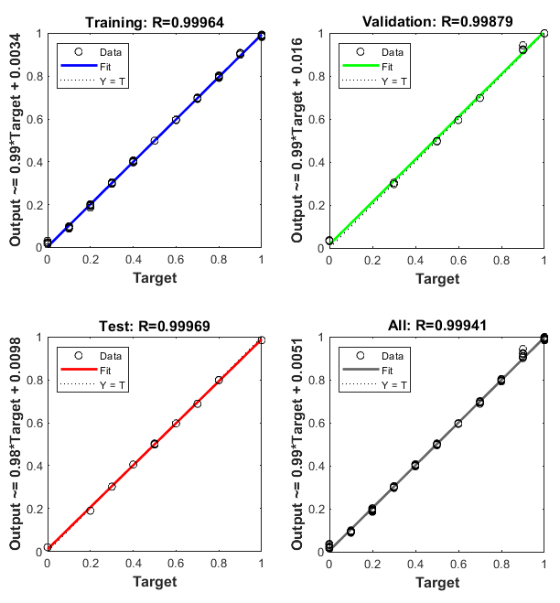
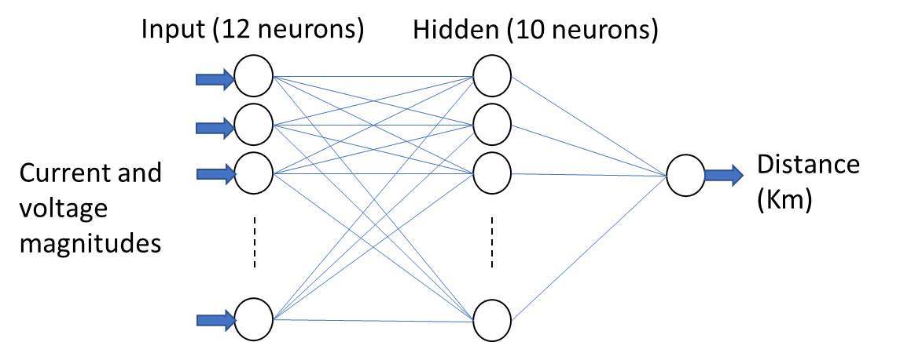
5
Fault location
offline
Training
fault distance (%) | 0 | 0.1 | 0.2 | 0.3 | 0.4 | 0.5 | 0.6 | 0.7 | 0.8 | 0.9 | 1
desired output | 0 | 0.1 | 0.2 | 0.3 | 0.4 | 0.5 | 0.6 | 0.7 | 0.8 | 0.9 | 1

Slide 28
5
Fault location
offline
Fault conditions
Section | Fault type | Fault resistance (Ω) | Desired output(Km) | Actual output(Km) | Error
7_5 | L-G | 10 | 80.50 | 86.098 | 0.032
 |  | 55 | 63.3 | 64.180 | 0.005
 |  | 65 | 33.6 | 35.673 | 0.012
 |  | 80 | 145 | 131.840 | 0.074
 |  | 0.5 | 50 | 51.130 | 0.006
 | L-L-G | 21 | 83 | 87.263 | 0.024
 |  | 80 | 94.7 | 98.667 | 0.022
 |  | 27 | 170 | 173.717 | 0.021
 |  | 12 | 76.93 | 84.674 | 0.044
 |  | 34 | 45.5 | 44.030 | 0.008
 | L-L | 8 | 169 | 176.181 | 0.041
 |  | 42 | 38.46 | 33.489 | 0.028
 |  | 134 | 93.6 | 92.594 | 0.006
 |  | 32 | 113 | 112.643 | 0.002
 |  | 0.5 | 150 | 151.823 | 0.010
 | L-L-L | 21 | 68 | 96.747 | 0.163
 |  | 150 | 100 | 105.642 | 0.032
 |  | 0.5 | 60 | 62.232 | 0.013
 |  | 8 | 9 | 12.172 | 0.018
 |  | 200 | 92 | 101.755 | 0.055
Testing
Training

Slide 29
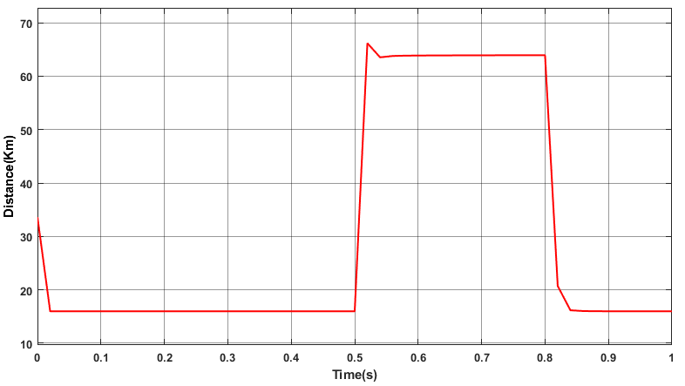

Slide 30
